Slide 1
IEEE 802.2 Logical Link Control
Prepared by
Divya K S
Adi Shankara Institute of Engineering & Technology
Kalady

Slide 2
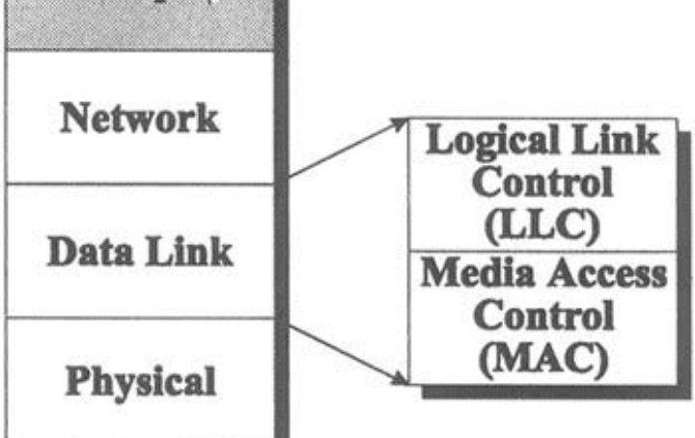
What is Logic link control?
In the IEEE 802 reference model of computer networking, the logical link control data communication protocol layer is the upper sublayer of the data link layer of the seven- layer OSI model.
The LLC sublayer acts as an interface between the media access control sublayer and the network layer.

Slide 3




Functions of LLC
Un-ACKed connectionless ACKed connectionless ACKed connection oriented Framing
Encoding Error control
Flow control (vs. congestion control?)

Slide 4
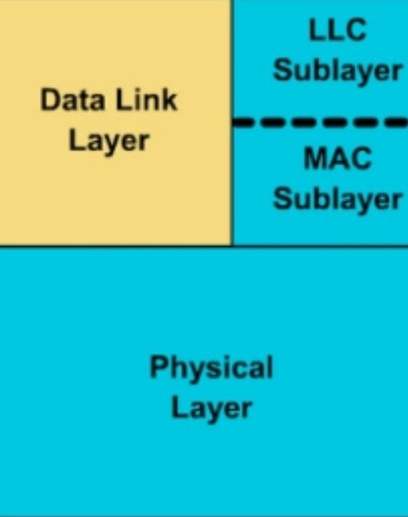
DDL Sub Layers
The data link layer is divided into two sublayers:
Logical Link Control (LLC) sublayer provides the logic for the data link. Thus, it controls the synchronization, flow control, and error checking functions of the data link layer.
Media Access Control (MAC) sublayer provides control for accessing the transmission medium. Perform data link functions,that depend on medium used.

Slide 5
IEEE 802.2
The IEEE 802.2 standards for Logical Link Control define a programming interface between that part of the communications software that controls the network interface card (the Media Access Control and Physical Medium Dependent components) and the overlying protocol stack (IP, NetBIOS, NetWare, etc.).
The connection between the network interface card and the rest of the communications system is through a structure called a Service Access Point .
The SAP differentiates between communications protocols; there’s a SAP for NetBIOS, another for SNA, another for NetWare, and so on.

Slide 6
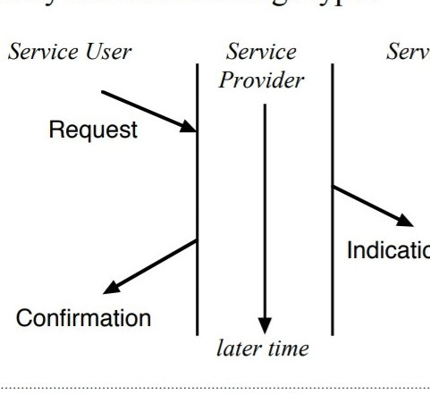
Protocol Diagrams
The 802.2 LLC protocols use three message types —
A Request is passed down to request a service
The Request appears at the “peer” service user as an Indication
A confirmation is returned to the requester.

Slide 7
Logical Link Control-Services
The Logical Link Control(LLC) has several service types
Service type 1, is a connectionless service with no establishment of a connection, and an unacknowledged delivery.
Service type 2,is a connection logical service with an acknowledgement of
delivery.
Service type 3,is a connectionless service with an acknowlegment of delivery.

Slide 8
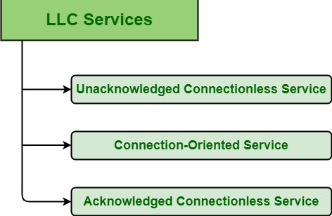

Slide 9
Unacknowledged Connectionless Service
In this service,destination machine do not send back any acknowledgment of receiving frames.
If a frame is lost due to noise,then no attempt is made to recover it.
Acknowledged Connectionless Service
In this type of service,there are no connection used but for each frame receive,the receiver sends an acknowledment to the sender.
If a frame is not received within specific time,then the sender will retransmit it.

Slide 10

Acknowledged Connection Oriented Service
The source and the destination machine establish a connection before transmitting the data.
A specific number given to each frame being sent and data link layer guarantees that each transmitted frame is received.
All frames are guaranteed to be received in the same order as the order of transmission.

Slide 11
Logical Link Control (LLC)
Protocol Data Unit
Logical Link Control (LLC) is a sublayer that generally provides the logic for the data link as it controls the synchronization, multiplexing, flow control, and even
error-checking functions of DLL (Data Link Layer).
DLL is divided into two sublayers i.e. LLC sublayer and MAC (Medium Access
Control) sublayer.
The basic model of LLC protocols is modeled after the HDLC (High-Level Data Link Control). These protocol are unacknowledged connectionless service, Connection- oriented service, and acknowledgedconnectionless service. All of these protocols use the same PDU (Protocol Data unit).

Slide 12

PDU Format
This PDU format basically contains 4 different fields
Destination Service Access Point (DSAP) Field
DSAP is generally an 8-bit long field that is used to represent the logical addresses of the network layer entity meant to receive the message. It indicates whether this is an individual or group address.

Slide 13


PDU Format
Source Service Access Point (SSAP) Field
SSAP is also an 8-bit long field that is used to represent the logical addresses of the network layer entity meant to create a message. It indicates whether this is a
command or response PDU. It simply identifies the SAP that has started the PDU.
Information Field
This field generally includes data or information.

Slide 14

PDU Format
Control Field
This field identifies and determines the specific PDU and also specifiesvarious control functions. It is an 8 or 16-bit long field, usually depending on the identity of the PDU.
It is used for flow and error control. There are basically three types of PDU. Each PDU has a different control field format.
1.Information(I) 2.Supervisory(S) 3.Unnumbered(U)

Slide 15
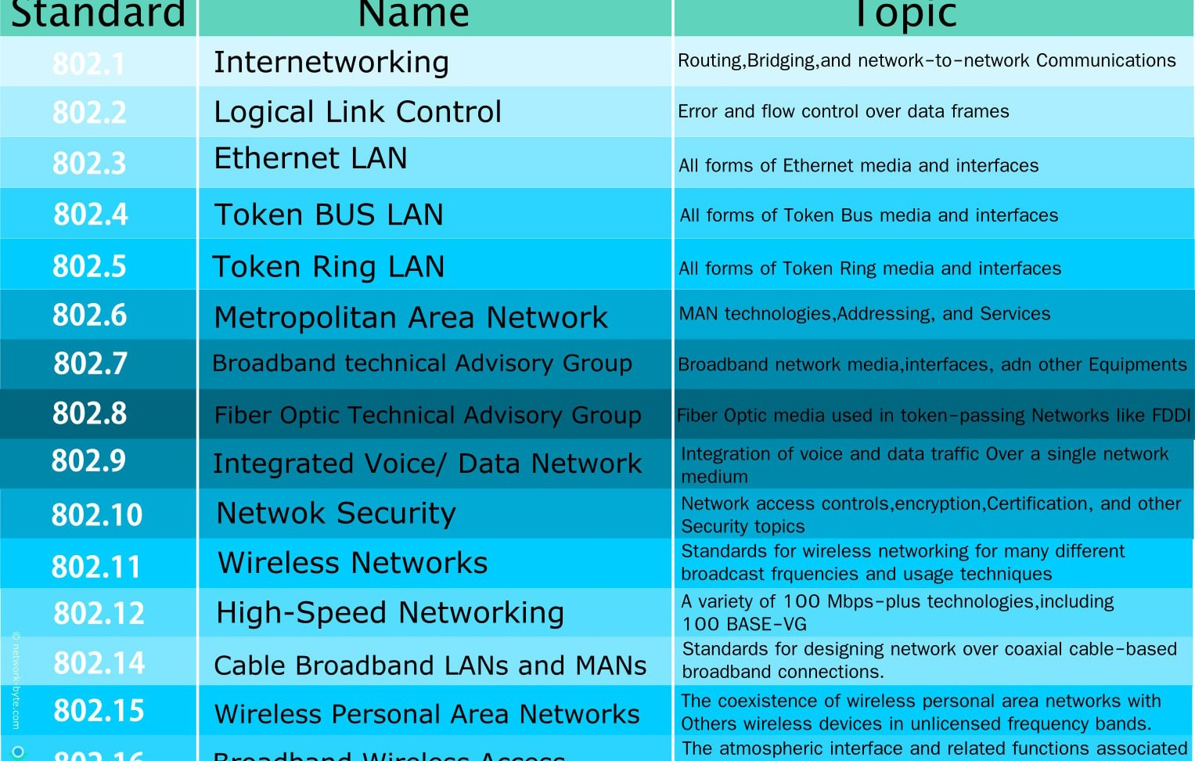
IEEE 802 Standards

